Slide 1
Crawl, Walk, Talk WP8.1 App Lifecycle and Speech API
Danny Warren
@dannydwarren

Slide 2
About Danny & InterKnowlogy
InterKnowlogy (www.interknowlogy.com)
15 year old services firm – Custom Application Development
Focused on building NUI solutions
Windows, Windows Phone, Xamarin, WPF, Kinect, Azure
Web, Mobile, Desktop, Touch, and Touchless
Formal R&D program: RECESS
Self guided learning/My time to prepare this presentation
Danny Warren, Sr. Software Engineer
Graduate Neumont University 2009, B.S. C.S.
Microsoft MVP in Windows Platform Development
Avid Mt. Biker and aspiring Rock Climber

Slide 3


App Lifecycle
Invisible but EXTREMELY important!
Affects
UX
Data
Possible Facial Side Effects
GOOD
BAD

Slide 4
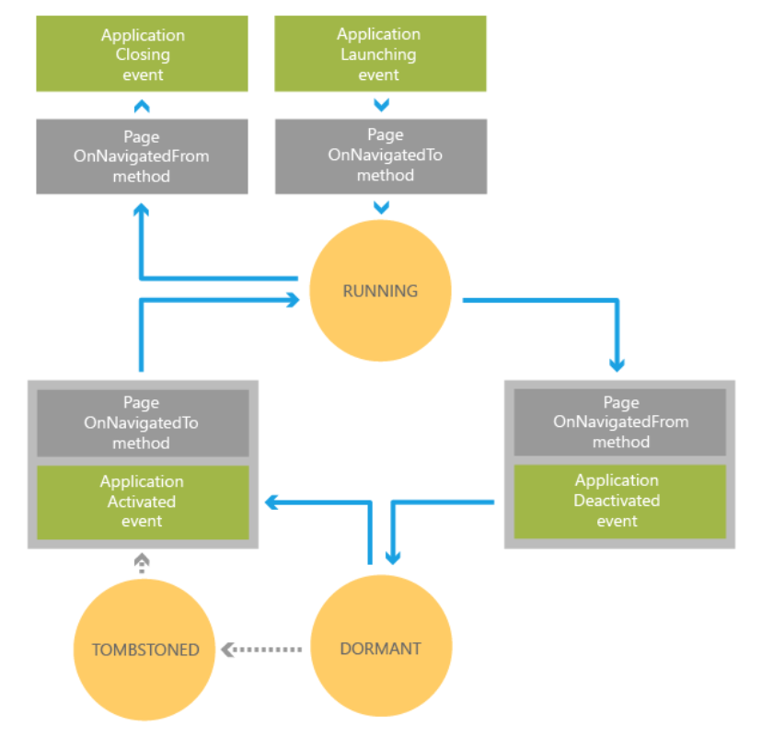

Slide 5
Windows Phone 8.1 Speech API
Voice Commands
VCD.xml file
Used to Launch Apps
Speech Recognition
Grammars
Recognizers
Text-To-Speech (TTS)
Error Help Here

Slide 6
Voice Commands
Create VCD.xml File
Register VCD File
Update Phrase Lists
Now support dictation variables
Declare Capabilities in WMAppManifext.xml
Microphone
Speech Recognition
Networking

Slide 7
Text-To-Speech (TTS)
SpeechSynthesizer
.SpeakTextAsync(“string”)
Literally stick words in the phone’s mouth!

Slide 8
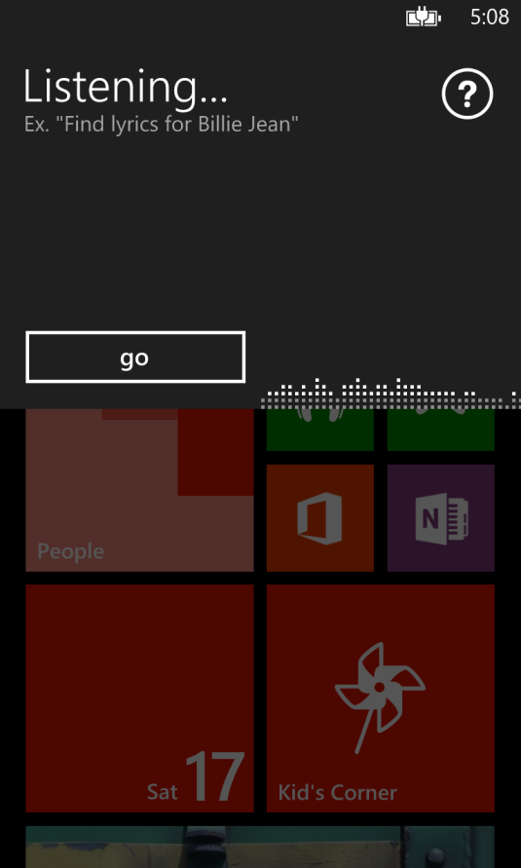
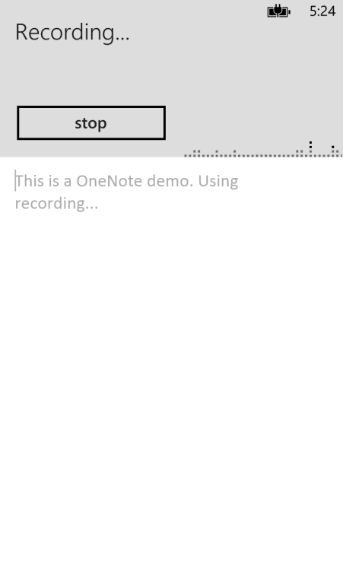
Speech Recognizers
SpeechRecognizerUI
SpeechRecognizer
Uses built in Speech UI
Good for basic uses
App must provide any desired UI for interaction
Good for custom uses

Slide 9
Choosing Between Grammars
Dictation and Web Search Grammar
This is the built in grammar
Must have network connectivity to use
Used by default when no other grammar specified
Programmatic List Grammar
Created in code from a list of strings
Extremely light weight, fast, and accurate
Speech Recognition Grammar Specification (SRGS File)
Extremely flexible
Fast and accurate

Slide 10

We Want YOU!
Contact Us
findyourcalling@interknowlogy.com mention devLink

Slide 11
Download Materials
http://blogs.interknowlogy.com/author/dannywarren/

